Slide 1
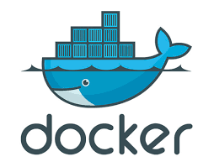
Software Security Report

Slide 2
Product Overview
Docker is an open source venture to mechanize the arrangement of utilizations as convenient, independent compartments that can run on cloud or on premises
Docker was founded by Solomon Hykes and Sebastien Pahl during the Y Combinator summer 2010 startup incubator group and launched in 2011
Factors to love Docker
Open Source
Security through Sandboxing
Faster development
Easier Iteration
Lightweight Reduction of Redundancy

Slide 3
Product Asset
Docker Daemon
Docker Repo
Docker Swarm
Source hub

Slide 4
Overview Findings for Docker security
The embedded security of the Kernel as well as support for namespaces and cgroups
Docker Daemon attack surface
Linux kernel capabilities
Docker Content Trust Signature Verfication

Slide 5
Number of Vulnerabilities
Docker officially released its new github repository in 2016.
Since then about 27 vulnerabilities were reported for Docker (not considering internal or external libraries, as well as extensions or plugins) in the CVE database
From these, 3 were above CVSS 9 (high) and one was 10.

Slide 6
Example Attacks
Attacks through REST API
Attacks through malicious containers
Attacks through third party application vulnerabilities

Slide 7
Vulnerabilities

Slide 8
CVE-2019-5736
Severity: 8.6 (high) according to CVSS:3.1
How exploit works:
Attacker can use a trojan horse which listens for user input. When user types ‘docker exec’ trojan horse will trigger malicious code which will run as root
Attacker can use a malicious Docker image. When this image is run by a user using ‘docker run’ malicious code will run.
How it was fixed: A separate read only copy of the file was created
When: 11th February 2019
Patch no.: Docker 18.09.2
.

Slide 9
CVE-2019-1020014
Severity: 5.5 (medium) according to CVSS:3.1
How exploit works:
The problem lies with a pointer which has been released twice. This extra free call has a possibility of crashing the program as the memory management data is corrupted. In some circumstances, the extra free releases another malloc (memory allocation). If an attacker is able to identify which memory is free, the system will be vulnerable to a buffer overflow attack.
How it was fixed: Controlling the double free
When: July 16th 2019
Patch no.: Docker-credentials-helper v0.6.3
.

Slide 10
CVE-2019-15752
Severity: 7.8 (high) according to CVSS:3.1
How exploit works:
The exploit runs a Metasploit script which puts a trojan horse in a Docker folder. This trojan horse will be executed whenever a user tries to authenticate into Docker. If this authentication is done by users with admin or service level privileges, the script too will be run with such privileges, essentially acting as a privilege escalation.
.
How it was fixed: Adding various security restrictions to the type of files which can be run, specifically to linux tools.
When: 8th August 2019
Patch no.: Docker Community Edition 2.1.0.1
.

Slide 11
CVE-2017-14992
Severity: 6.5(Medium) according to CVSS:3.1
How exploit works:
A certain line of code can read any number of end line notations (\0). This can be used by attackers by compressing a large amount of such characters and then pushing or pulling the file as a docker image. When the docker image is imported, it will be decompressed and the characters will take up most of the memory, essentially crashing the device
How it was fixed: Added tar header validation
When: 7th November 2017
Patch no.: tar-split v0.10.2 (Docker Engine 17.11)
.

Slide 12
Architecture Overview

Slide 13
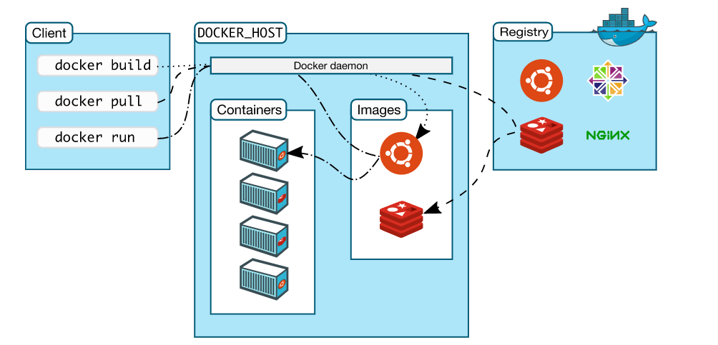
High Level Diagram

Slide 14
Basic Level Security and Design Principles
File System Protections
Capabilities
Namespaces and Control groups
Open Source code

Slide 15
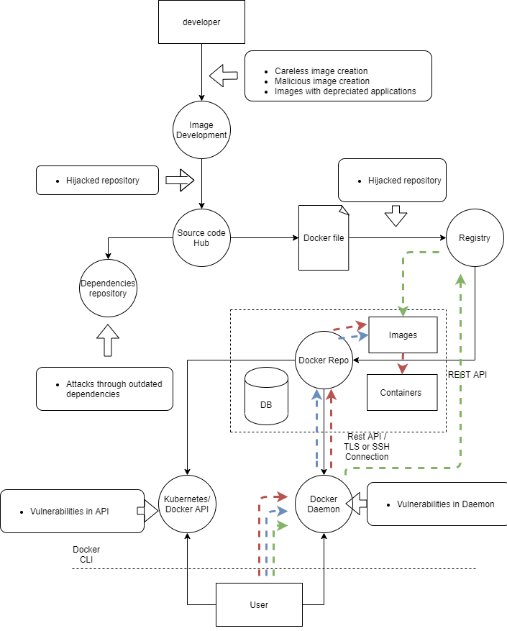
Threat model

Slide 16
Misuse/Abuse cases

Slide 17
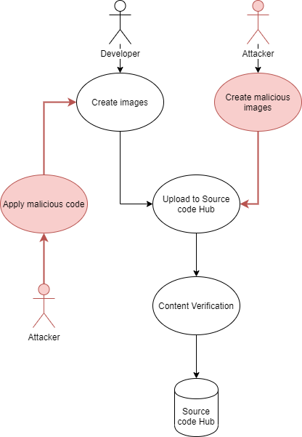
Process: Image develpoment
Asset: Source code Hub
Threat: Malicious image crafting
Vulnerability: Source hub has no strict content verification. This is as designed, though, because Docker files are created with various purposes including testing and security purposes, and thus content verification could cause a breakdown in functionality

Slide 18
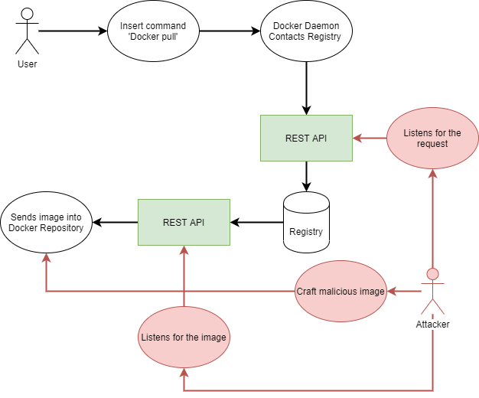
Process: Docker Pull
Asset: Registry
Threat: Man-in-the-middle attack when pulling images
Vulnerability: Vulnerabilities in the REST API used

Slide 19
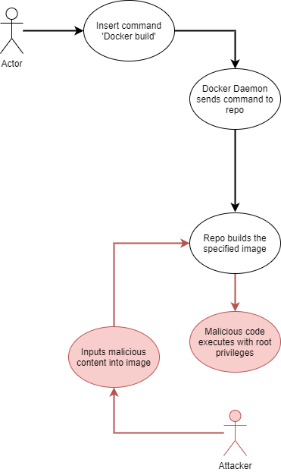
Process: Docker Build
Asset: Docker Repo (Containers) and Host
Threat: Unauthorized access to processes which need root/high-level privileges
Vulnerability: Docker build need certain root privileges to build the image

Slide 20
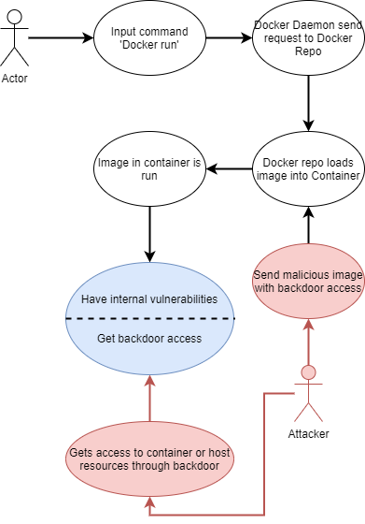
Process: Docker Run
Asset: Docker Daemon
Threat: Attacks through internal libraries
Vulnerability: Internal library vulnerabilities

Slide 21
Code Inspection

Slide 22
Osxkeychain_darwin.c
Folder path: docker/docker-credential-helpers/osxkeychain
Reason: Osxkeychain is the macOS mechanism used to store passwords and account information. The reason for selecting this file was because of the importance of account information control.
Basic Function: The main functions used in the page are as follows.
Keychain_add
Keychain_get
Keychain_delete
Keychain_list
Security related functionality: Since this code is related directly to software security, all functionality needs to be secure. Using the data dynamically and freeing the data after they’ve been used is a good security practice.

Slide 23
Disassemble.go
Folder path: Docker/engine/vendor/github.com/vbatts/tar-split/tar/asm
Reason: This file has code pertaining to tar unzipping which is an area which should be looked in security. This was selected as an optimal file for code inspection because of this
Basic Function: The whole functionality of this code is to disassemble a tar file
Security related functionality: In this code, security related functionality is mainly around controlling the tar unzipping without enabling any leaks in security.

Slide 24
Exec.go
Folder path: engine/daemon/exec
Reason: This code contains the implementation for ‘docker exec’, which essentially opens a new shell to be used. As such, the input and output must handled as it could be used by attackers to execute malicious scripts. The reason this was selected for a security code inspection is to learn how a software such as Docker will sanitize command execution
Basic Function: The main functionality pertains to execution, logging and input validation of ‘docker exec’ commands.
Security related functionality: The code works by opening the input stream to record the command and is closed immediately afterwards ( using CloseStreams()). This will stop any attackers from adding any malicious code. These exec functions are also archived for auditing purposes.

Slide 25
Pull.go
Folder path: engine/distribution)
Reason: This page acts as an intermediary when ‘docker pull’ command is executed. Since this is one of the main functionalities, it was thought of as a good file for code inspection.
Basic Function: The functionality of this page is to facilitate pulling images.
Security Related functionality: The security related functionality in this page is the function for adding cryptographic checksums, or in this case, the digest using ‘addDogestReference’. What the function does is check the store for a digest. If so, it would add it to the pulled image so that it can be verified

Slide 26
Product Specific Checklist

Slide 27
Domain Specific Concerns
RunC library
Internal and external libraries
Plugins

Slide 28
Coding Mistakes
Using depreciated functionality
Not using values assigned to local variables
Incorrect condition (Off-by-one)

Slide 29
Design concerns
XSS vulnerabilities
Overflow possibilities

Slide 30
Thank you!!!

